Slide 1
Making this resource work for you
Prior to teaching this lesson, please refer to the ‘Unit Overview and Planning Document’.
Further guidance on planning Science Mastery lessons can be found in the detailed planning guidance document.
Refer to the ‘notes’ section on each slide for useful information, including suggested expositions, pedagogical content knowledge, suggested questions, answers and more. Consider using presenter mode so you can see this guidance throughout the lesson.
The introduction slides can be adapted to suit your teaching style and the needs of your class.
Before the lesson, adapt the fix-it slide to address any misconceptions identified in the previous lesson’s exit ticket.
Choose from the suggested activities to suit your class. The intention is not that you complete all of these, but that you select those which ones are most appropriate for your students. It may be appropriate to further adapt activities for your students.
These lessons are designed to occupy approximately 1 hour. To adapt for a shorter or longer lesson duration we advise you to adapt the activity section accordingly.
Please consider using the final slide to send feedback about this lesson or examples of PowerPoints that you have adapted to our design team. Your feedback is used to improve Science Mastery for all of our teachers and students. We appreciate all suggestions and comments.
Thank you for reading!
The Science Mastery Team

Slide 2

Combustion of Hydrocarbons
Answer the questions below.
Name the process used to separate crude oil.
Explain how this process separates crude oil.
Describe the pattern of viscosity as hydrocarbon chains get longer.
Name the alkane that contains two carbon atoms.
Explain the difference between an exothermic and an endothermic reaction.
Fractional distillation
Hydrocarbons evaporate and condense at different temperatures depending on their boiling point.
As hydrocarbon chains get longer, viscosity increases.
Ethane
An exothermic reaction transfers energy to the surroundings whereas an endothermic reaction takes in energy from the surroundings.
Notes:
Big idea: Reactions rearrange matter
Foundation: Determine how many hydrogen atoms there are in an alkane with 12 carbon atoms.
Stretch: Explain why the short chain alkanes are suitable to be used as domestic fuels.
Answers:
Foundation: 26
Stretch: They are highly flammable so ignite easily, making them suitable to burn to release energy.

Slide 3
Combustion of Hydrocarbons
Do Now:
Name the process used to separate crude oil.
Explain how this process separates crude oil.
Describe the pattern of viscosity as hydrocarbon chains get longer.
Name the alkane that contains two carbon atoms.
Explain the difference between an exothermic and an endothermic reaction.
Drill:
Name the compound with the formula CH₄.
Calculate the relative formula mass of propane. C=12, H=1
Calculate the percentage by mass of carbon in ethane.
Notes:
Drill answers:
Methane
C₃H₈ = (12x3)+(8x1) = 44
Mr = (12x2)+(6x1) = 30
% by mass = 24/30 x100 = 80%

Slide 4
Combustion of Hydrocarbons
Read Now:
Many of the hydrocarbons in crude oil are used as fuels. A fuel is any substance that is burned to release energy. Combustion is the chemical reaction that takes place when a substance burns in air, so when hydrocarbons are burned, these are combustion reactions. These reactions are useful as they are highly exothermic, which means they transfer a large amount of energy to the surroundings. The main advantage of burning hydrocarbons is this release of energy, although there are also disadvantages. Combustion of hydrocarbons produces carbon dioxide as a product, which contributes to global warming. Scientists and companies are developing new fuels that are less harmful to the environment, but humans are still dependent on crude oil as a fuel source for heating homes, gas for cooking and fuel for cars and other modes of transport.
Explain what is meant by a fuel.
Explain what is meant by a combustion reaction.
Explain why combustion of hydrocarbons is a useful chemical reaction.
Give a disadvantage of burning hydrocarbons.
Describe two uses of hydrocarbons for humans.

Slide 5

C5.1.4
15/08/2024
Combustion of Hydrocarbons
C5.1.1 Prior Knowledge Review
C5.1.2 Crude Oil and Hydrocarbons
C5.1.3 Fractional Distillation
C5.1.4 Combustion of Hydrocarbons
C5.1.5 Cracking
C5.1.6 Taking it Further: Alkenes
C5.1.7 Taking it Further: Alcohols
C5.1.8 Taking it Further: Producing Ethanol by Fermentation
C5.1.9 Taking it Further: Producing Ethanol from Ethene
C5.1.10 Taking it Further: Carboxylic Acids
C5.1.11 Taking it Further: Esters
C5.1.12 Polymers
C5.1.13 Taking it Further: Addition Polymerisation
C5.1.14 Taking it Further: Condensation Polymerisation
C5.1.15 Taking it Further: Naturally Occurring Polymers
Notes:
Big Idea: Structure Determines Properties
In the previous lessons students were introduced to crude oil and fractional distillation. In this lesson, they will look at how they are used to release energy, linking back to exothermic reactions from C4.4.
Suggested Hook:
This can be an opportunity to show students how a Bunsen burner actually works, simply by lighting it. The gas from a gas tap is methane and when it is lit, this provides energy to start the combustion reaction.
What is a combustion reaction?
What is something reacting with if it burns in air?

Slide 6

Following this lesson, students will be able to:
State the general equation for the combustion of alkanes
Describe the advantages and disadvantages of the combustion of hydrocarbons
Explain the difference between complete and incomplete combustion
Key Words:
alkane
combustion
incomplete
exothermic
oxidation
Notes:
Guidance:
See unit overview document and planning guidance to see how these objectives are typically assessed at GCSE, including examples of what students should be able to do following this lesson.
Planning for different needs:
The learning objectives given on this slide are suggested based on the most common requirements for exams, however they can be adapted based on the needs of different classes.
For best practice, the unit preparation booklet should be used to determine the appropriate focus of lessons within the unit.
While it is not possible to explicitly split content into levelled grades, we recommend that lesson objectives can be classified as critical, core or stretch.
Critical: the content or skill is essential for all students to be able to progress.
Core: the content or skill is important for students to progress, but other opportunities may be available to revisit it.
Stretch: the content or skill may not be essential for all students but is important for students aiming for the highest grades.
Key skill: this is a crucial skill being developed in this unit as part of the skill mapping
C5.1.4 Lesson Objectives:
Critical: State the general equation for the combustion of alkanes
Core: Describe the advantages and disadvantages of the combustion of hydrocarbons
Core: Explain the difference between complete and incomplete combustion

Slide 7
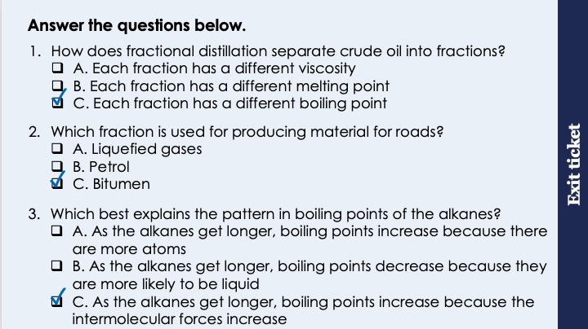
This is the fix-it portion of the lesson
The fix-it is an opportunity to respond to gaps in knowledge, especially those identified by the pre-unit quiz.
The teacher should customise this slide as needed, to facilitate
reteach, explanation, demonstration or modelling of ideas and concepts that students have not yet grasped or have misunderstood.
practise answering specific questions or of key skills.
redrafting or improving previous work.
Notes:
Purpose: to spend time on any gaps identified in previous learning from previous exit ticket.
Guidance from previous exit ticket:
Q1. Answer: C
If students answer A, they may have confused the idea of viscosity with the heavier fractions. If students answer B, they are not clear on the specific state changes that occur during fractional distillation. To fix it, review why fractions are separated by heating.
Q2. Answer: C
If students answer A, they have got the fractions the wrong way round. If students answer B, they have confused the idea of fuels for cars with the actual road materials. To fix it, review what different fractions are used for.
Q3. Answer: C
If students answer A, they have recognised the pattern is to do with the length of the molecules but not understood that this is due to the intermolecular forces (because there are more atoms). If students answer B, they have the misconception that low boiling points means substances will be liquids. To fix it, review the pattern of boiling points in the alkanes and get students to explain this in their own words.

Slide 8

Combustion of Hydrocarbons
Many of the hydrocarbons found in crude oil can undergo combustion.
Combustion of hydrocarbons releases a lot of energy, which is why they are useful as fuels.
The general equation for the combustion of alkanes is:
Alkane + oxygen → carbon dioxide + water
Carbon and hydrogen from the alkane are both oxidised as they gain oxygen.
Notes:
Suggested exposition:
In the last lesson we looked at the different fractions that can be separated from crude oil in fractional distillation. Once they have been separated into these fractions, each of these fractions is used for a different purpose depending on their properties.
Many of the hydrocarbons are used as fuels. A fuel is any substance that can be burned (or undergo a chemical reaction) to release energy. This is why hydrocarbons are so useful for humans - they are burned as domestic fuels for heating and cooking (like in a gas boiler) or burned in combustion engines in cars and other larger transport vehicles.
When hydrocarbons are burned, these are combustion reactions. These combustion reactions release a lot of energy, so they are highly exothermic, as lots of energy is transferred to the surroundings. This energy is then transferred into different stores (e.g. thermal or kinetic) depending on what the fuel is being used for.
When hydrocarbons are burned, they react with oxygen in the air. Remember that air is a mixture of gases and it is specifically the oxygen in air that substances react with when they burn. This reaction produces carbon dioxide and water.
Since Year 7 we have talked about how burning fossil fuels releases carbon dioxide, which exacerbates global warming. This is the chemical equation behind that. Hydrocarbons are fossil fuels as they are obtained from crude oil.
If we know that burning hydrocarbons releases carbon dioxide, why do we do it?
Humans are still heavily dependent on hydrocarbons for fuel, and a huge proportion global infrastructure is based around the burning of hydrocarbons to release energy.
During hydrocarbon combustion, carbon and hydrogen are both oxidised. They gain oxygen.
(Note - oxidation in terms of oxidation is used here. Oxidation in terms of electrons is only needed when ionic equations are involved).
One of the easiest places we can actually see combustion of a hydrocarbon is in a Bunsen burner.
Demo: turn Bunsen burner on with the air hole fully open.
Gas taps supply methane.
What is the chemical formula for methane?
CH₄.
Methane is an alkane and when we light the gas, it ignites easily and burns to release energy. Methane is used as it is a small molecule.
What is the pattern with flammability and the length of a hydrocarbon chain?
The smaller the molecule, the more flammable it is.
When we have the Bunsen burner hole fully open, there is a good supply of air and therefore oxygen for the methane to react with. This is complete combustion.

Slide 9
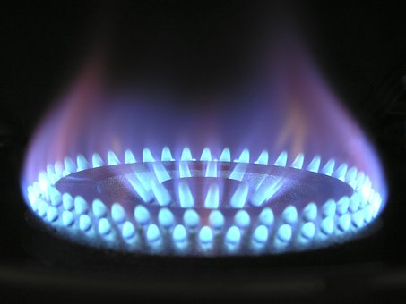
Complete Combustion
When there is a good supply of air (and therefore oxygen), complete combustion takes place.
Alkane + oxygen → carbon dioxide + water
Methane + oxygen → carbon dioxide + water
2
CH₄ + O₂ → CO₂ + H₂O
2
This reaction is highly exothermic as it transfers a lot of energy to the surroundings.
Notes:
Suggested exposition:
When hydrocarbons burn in a good supply of oxygen, complete combustion takes place.
The products of this are carbon dioxide and water.
For example, in a Bunsen burner, methane reacts with oxygen to produce carbon dioxide and water.
This can be written as a word equation or a balanced symbol equation, but the general equation is the same for all the alkanes.
The gas used on cooking stoves is usually propane, which still produces carbon dioxide and water.
Complete combustion is highly exothermic, as lots of energy is transferred to the surroundings.
Image from pixabay

Slide 10
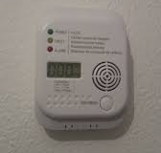
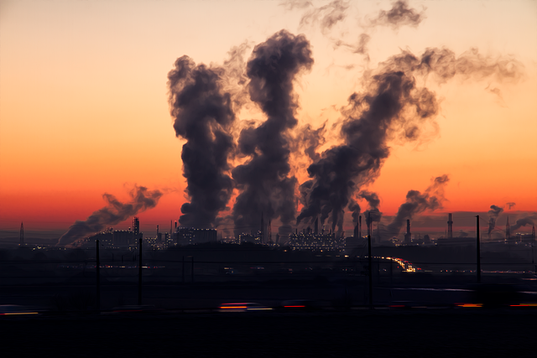
Incomplete Combustion
When there is a limited supply of air (and therefore oxygen), incomplete combustion takes place.
This still produces water but produces carbon and carbon monoxide rather than carbon dioxide.
This reaction is also exothermic but releases less energy than complete combustion.
Carbon monoxide is very dangerous as it is toxic.
Another problem with burning hydrocarbons is that some may contain sulfur impurities, which burn to produce sulfur dioxide and leads to acid rain.
Notes:
Suggested exposition:
Hydrocarbon fuels can undergo complete combustion or incomplete combustion, depending on the amount of oxygen available.
Complete combustion takes place when there a plentiful supply of air (and therefore oxygen), such as when the air hole on a Bunsen burner is open. This releases a lot of energy.
Incomplete combustion happens when there is a limited supply of air or oxygen. Water is still produced, but carbon monoxide and carbon are produced. The reaction is still exothermic but less energy is released than during complete combustion.
In a Bunsen burner, incomplete combustion occurs when the air hole is closed.
You may have seen soot before after a fire, when something has not burned fully. This is the carbon produced through incomplete combustion.
The other product of incomplete combustion is carbon monoxide, which is very dangerous. It is a colourless and odourless gas but is extremely toxic. All houses must be fitted with a carbon monoxide detector. It binds to haemoglobin in blood which means that oxygen cannot bind to the haemoglobin and therefore no oxygen can be carried around the body.
Another big problem with burning hydrocarbons is that some contain sulfur impurities. When the hydrocarbon is burned, the sulfur impurities also react with oxygen to produce sulfur dioxide, which leads to acid rain. We will learn more about this when we look at atmospheric gases and pollution in unit C5.3.
Image source:
CC@https://commons.wikimedia.org/wiki/File:FA370_Carbon_monoxide_detector,_The_Hague_(2019)_01.jpg
Pollution from pixabay

Slide 11




Which statements do you agree with?
Combustion of alkanes takes in energy from the surroundings
Combustion of alkanes releases energy to the surroundings
During combustion, alkanes react with air
During combustion, alkanes react with oxygen
Notes:
Suggested points:
This talk task is designed to ensure that students are clear on the properties of the different fractions, drawing out if they understand the difference between high and low volatility and viscosity.
Blue: correct
Yellow: incorrect
Green: incorrect
Pink: correct
Suggested guidance:
Talk tasks can be used in a variety of ways to suit the particular needs of the students you are teaching. Through exchanging views with others, students develop their understanding of the science beyond what could be achieved individually.
Science classrooms that successfully integrate talk have the following features:
Science talk is a regular feature of lessons and is woven into classroom activities.
Students are paired or grouped strategically by the teacher to ensure productive interaction. This might take into consideration the students’ proficiency of the English language, how encouraging they might be to peers and their attainment in the topic. It’s a good idea to consider these pairings in the class seating plan.
Students are encouraged and supported to talk, but are not forced to talk.
The teacher should take on the role of a facilitator, engaging with conversations where necessary and encouraging or steering the conversation where needed.
Students are encouraged to use the language they have to express their ideas (e.g., everyday language, imperfect English, native language), but also to incorporate science specific terminology where this is more accurate or has been taught.
6. Scientifically inaccurate ideas are not dismissed by the partner or teacher; open discussion and further investigation are relied on to help students construct ideas that support them to progress in their scientific understanding.
7. Guidelines for behaviour during talk tasks are explicit and frequently reviewed. Rules for students might be:
Listen carefully to your partner
Take turns talking.
Speak one at a time, without interrupting.
Politely agree or disagree and explain why.
Politely point out if your partner has used a scientific word incorrectly, if they have explained the science incorrectly, or if there is a more accurate way to describe something.
If confused, ask questions.
Stay focused on the discussion topic.
Respond to one another.

Slide 12

How many links can make between this lesson and the science you’ve learned before?
What type of reaction is combustion?
What would the reaction profile for combustion look like?
What type of bonding is found in hydrocarbons?
What are the products of combustion of alkane?
What does this have to do with global warming?
What are the biological consequences of global warming?
Notes:
Suggested guidance:
Talk tasks can be used in a variety of ways to suit the particular needs of the students you are teaching. Through exchanging views with others, students develop their understanding of the science beyond what could be achieved individually.
Science classrooms that successfully integrate talk have the following features:
Science talk is a regular feature of lessons and is woven into classroom activities.
Students are paired or grouped strategically by the teacher to ensure productive interaction. This might take into consideration the students’ proficiency of the English language, how encouraging they might be to peers and their attainment in the topic. It’s a good idea to consider these pairings in the class seating plan.
Students are encouraged and supported to talk, but are not forced to talk.
The teacher should take on the role of a facilitator, engaging with conversations where necessary and encouraging or steering the conversation where needed.
Students are encouraged to use the language they have to express their ideas (e.g., everyday language, imperfect English, native language), but also to incorporate science specific terminology where this is more accurate or has been taught.
6. Scientifically inaccurate ideas are not dismissed by the partner or teacher; open discussion and further investigation are relied on to help students construct ideas that support them to progress in their scientific understanding.
7. Guidelines for behaviour during talk tasks are explicit and frequently reviewed. Rules for students might be:
Listen carefully to your partner
Take turns talking.
Speak one at a time, without interrupting.
Politely agree or disagree and explain why.
Politely point out if your partner has used a scientific word incorrectly, if they have explained the science incorrectly, or if there is a more accurate way to describe something.
If confused, ask questions.
Stay focused on the discussion topic.
Respond to one another.

Slide 13
Balancing Equations Challenge
The chemical equation for the combustion of ethane is:
2
7
4
6
3.5
2
C₂H₆ + O₂ → CO₂ + H₂O
3
Can you balance this equation?
2 C₂H₆ + 7 O₂ → 4 CO₂ + 6 H₂O
Notes:
Note: Generally in exams, students will be expected to balance the equation for either methane or propane, as those do not involve multiples for the alkane, so this is a deliberately challenging question, which some students may need support with.
Suggested guidance:
Talk tasks can be used in a variety of ways to suit the particular needs of the students you are teaching. Through exchanging views with others, students develop their understanding of the science beyond what could be achieved individually.
Science classrooms that successfully integrate talk have the following features:
Science talk is a regular feature of lessons and is woven into classroom activities.
Students are paired or grouped strategically by the teacher to ensure productive interaction. This might take into consideration the students’ proficiency of the English language, how encouraging they might be to peers and their attainment in the topic. It’s a good idea to consider these pairings in the class seating plan.
Students are encouraged and supported to talk, but are not forced to talk.
The teacher should take on the role of a facilitator, engaging with conversations where necessary and encouraging or steering the conversation where needed.
Students are encouraged to use the language they have to express their ideas (e.g., everyday language, imperfect English, native language), but also to incorporate science specific terminology where this is more accurate or has been taught.
6. Scientifically inaccurate ideas are not dismissed by the partner or teacher; open discussion and further investigation are relied on to help students construct ideas that support them to progress in their scientific understanding.
7. Guidelines for behaviour during talk tasks are explicit and frequently reviewed. Rules for students might be:
Listen carefully to your partner
Take turns talking.
Speak one at a time, without interrupting.
Politely agree or disagree and explain why.
Politely point out if your partner has used a scientific word incorrectly, if they have explained the science incorrectly, or if there is a more accurate way to describe something.
If confused, ask questions.
Stay focused on the discussion topic.
Respond to one another.

Slide 14
Determine if each of these statements are true or false
True
The alkane with one carbon is called methane
Combustion of propane produces water and oxygen
The products of combustion are different depending on which alkane reacted
Incomplete combustion occurs when there is insufficient oxygen
Carbon dioxide produced from combustion is the main cause of acid rain
False
False
True
False

Slide 15
Drill
Name the substance that hydrocarbons react with during combustion.
State the two products of combustion of hydrocarbons.
Identify which product is linked to global warming.
Explain the difference between complete and incomplete combustion.
Describe how sulfur dioxide is formed.
State the environmental problem associated with sulfur dioxide.
Explain which fractions of crude oil can be burned most easily.
Notes:
Purpose: This is a knowledge drill. The purpose of this is to check that the critical knowledge is secure before pupils move onto independent practice.
Suggested guidance: There are a range of ways this could be done depending on time and ability range of the class:
Mini whiteboards
As full sentences in exercise books
As short answers in exercise books
In the pupil workbook
As pair talk
As cold call

Slide 16
Drill answers
Oxygen
Water and carbon dioxide
Carbon dioxide
Complete combustion happens when there is plenty of oxygen available whereas incomplete combustion occurs when there is not enough oxygen. Incomplete combustion produces carbon and carbon monoxide (and water) rather than carbon dioxide (and water).
Hydrocarbon fractions many contain sulfur impurities, which react with oxygen during combustion to form sulfur dioxide.
Acid rain
The fractions with the shortest hydrocarbon chains as they are most flammable.
Notes:
Purpose: This is a knowledge drill. The purpose of this is to check that the critical knowledge is secure before pupils move onto independent practice.
Suggested guidance: There are a range of ways this could be done depending on time and ability range of the class:
Mini whiteboards
As full sentences in exercise books
As short answers in exercise books
In the pupil workbook
As pair talk
As cold call

Slide 17
I: Combustion Reactions
H
Methane burns in air.
What is the chemical formula for methane?
H
C
H
CH₄
Draw the structural formula for methane.
H
Write a word equation for the combustion of methane.
Methane + oxygen → carbon dioxide + water
Write a symbol equation for the combustion of methane.
CH₄ + O₂ → CO₂ + H₂O
Balance the symbol equation.
CH₄ + 2 O₂ → CO₂ + 2 H₂O
Notes:
Purpose: The I-We-You section aims to support pupils to build skills that they most commonly need when answering questions associated with this knowledge in the assessment. This section is also used to interleave other content we expect pupils to know at this stage of their education in order that they build a big picture of the science they are learning.
For the ‘I’ activity, the teacher should model how to answer the question. They can do this by narrating their thinking process aloud, and making links to learning earlier in the lesson explicit.
For the ‘we’ activity, the teacher and students work though a similar example together, in order to prepare students to be able to answer a similar question independently.
Opportunities for the ‘you’ activity – independent practise – occur in the activity portion of the lesson once the student is secure enough to process independently.

Slide 18
We: Combustion Reactions
Propane burns in air.
H
H
H
What is the chemical formula for propane?
H
C
C
C
H
C₃H₈
Draw the structural formula for propane.
H
H
H
Write a word equation for the combustion of propane.
Propane + oxygen → carbon dioxide + water
Write a symbol equation for the combustion of propane.
C₃H₈ + O₂ → CO₂ + H₂O
Balance the symbol equation.
C₃H₈ + 5 O₂ → 3 CO₂ + 4 H₂O
Notes:
Purpose: The I-We-You section aims to support pupils to build skills that they most commonly need when answering questions associated with this knowledge in the assessment. This section is also used to interleave other content we expect pupils to know at this stage of their education in order that they build a big picture of the science they are learning.
For the ‘I’ activity, the teacher should model how to answer the question. They can do this by narrating their thinking process aloud, and making links to learning earlier in the lesson explicit.
For the ‘we’ activity, the teacher and students work though a similar example together, in order to prepare students to be able to answer a similar question independently.
Opportunities for the ‘you’ activity – independent practise – occur in the activity portion of the lesson once the student is secure enough to process independently.

Slide 19
You: Combustion Reactions
H
H
H
H
H
Pentane (C₅H₁₂) burns in air.
H
C
C
C
C
C
H
Draw the structural formula for pentane.
H
H
H
H
H
Write a word equation for the combustion of pentane.
Pentane + oxygen → carbon dioxide + water
Write a symbol equation for the combustion of pentane.
C₅H₁₂ + O₂ → CO₂ + H₂O
Balance the symbol equation.
C₅H₁₂ + 8 O₂ → 5 CO₂ + 6 H₂O
Notes:
Purpose: The I-We-You section aims to support pupils to build skills that they most commonly need when answering questions associated with this knowledge in the assessment. This section is also used to interleave other content we expect pupils to know at this stage of their education in order that they build a big picture of the science they are learning.
For the ‘I’ activity, the teacher should model how to answer the question. They can do this by narrating their thinking process aloud, and making links to learning earlier in the lesson explicit.
For the ‘we’ activity, the teacher and students work though a similar example together, in order to prepare students to be able to answer a similar question independently.
Opportunities for the ‘you’ activity – independent practise – occur in the activity portion of the lesson once the student is secure enough to process independently.

Slide 20
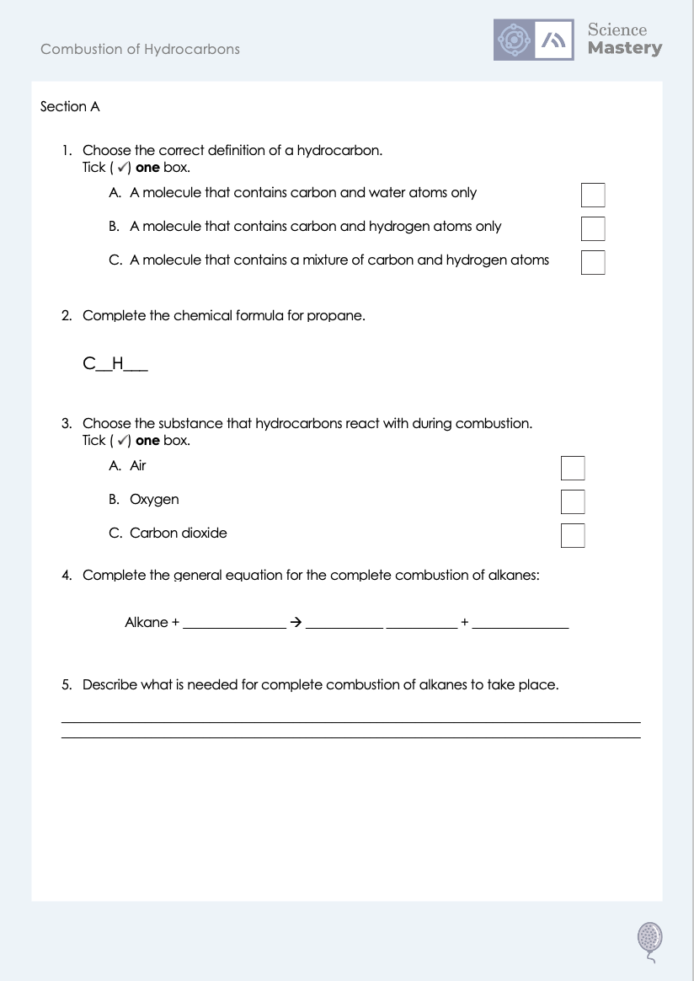
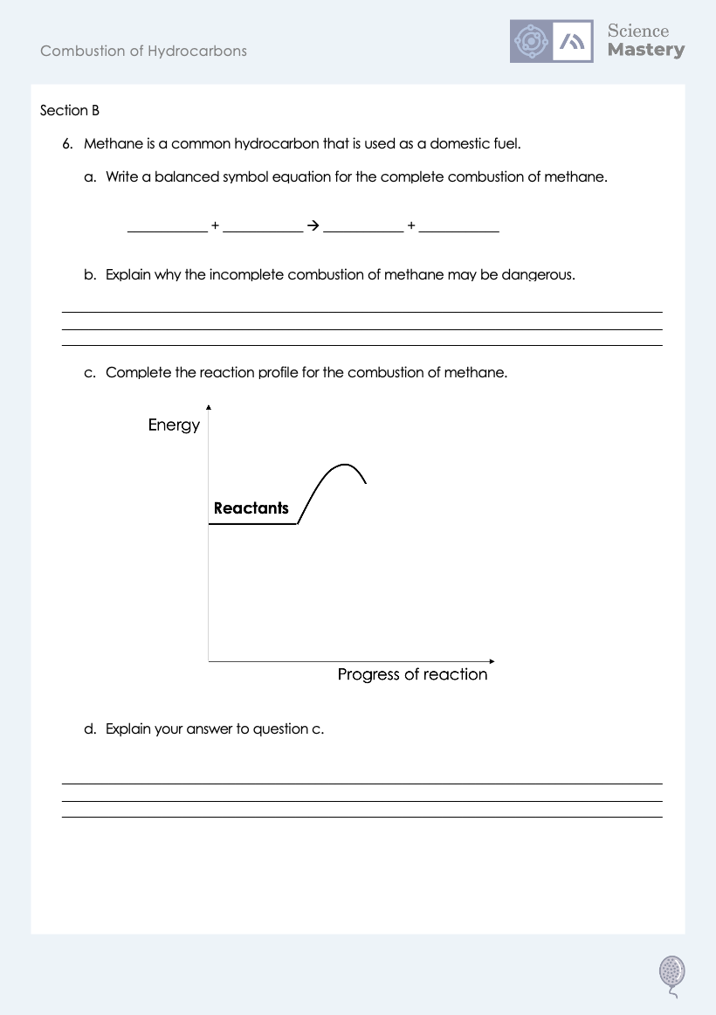
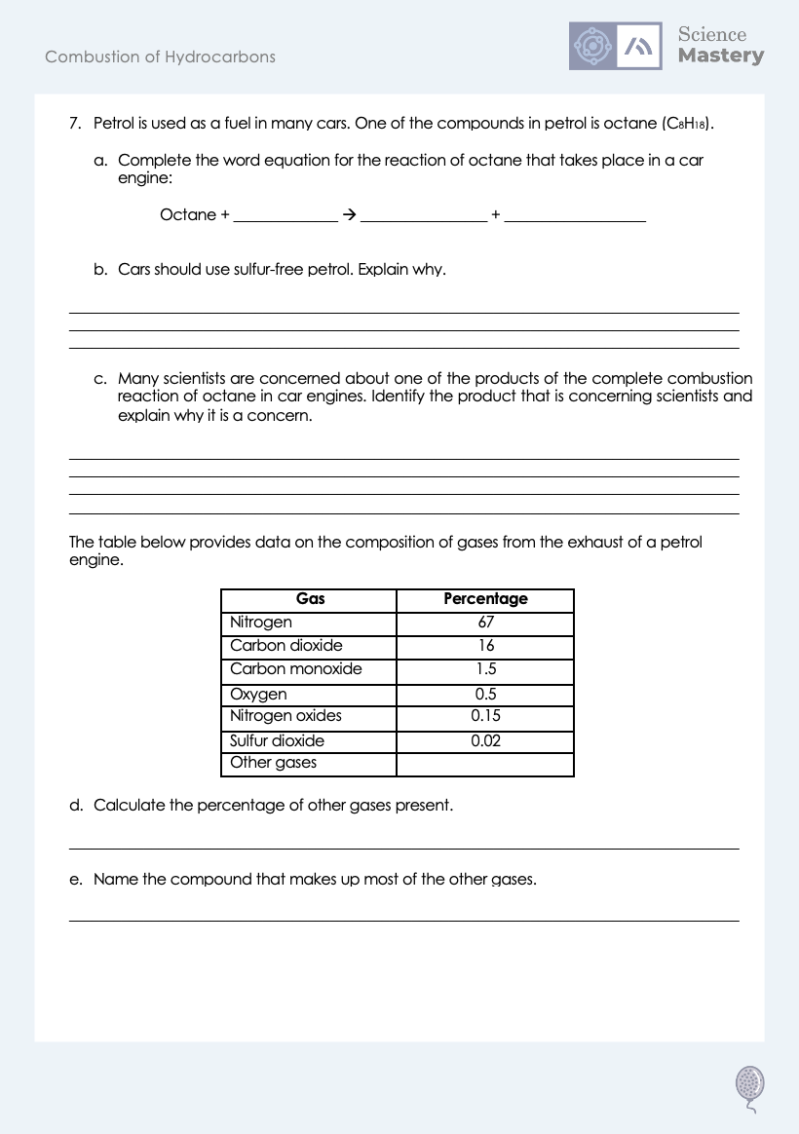
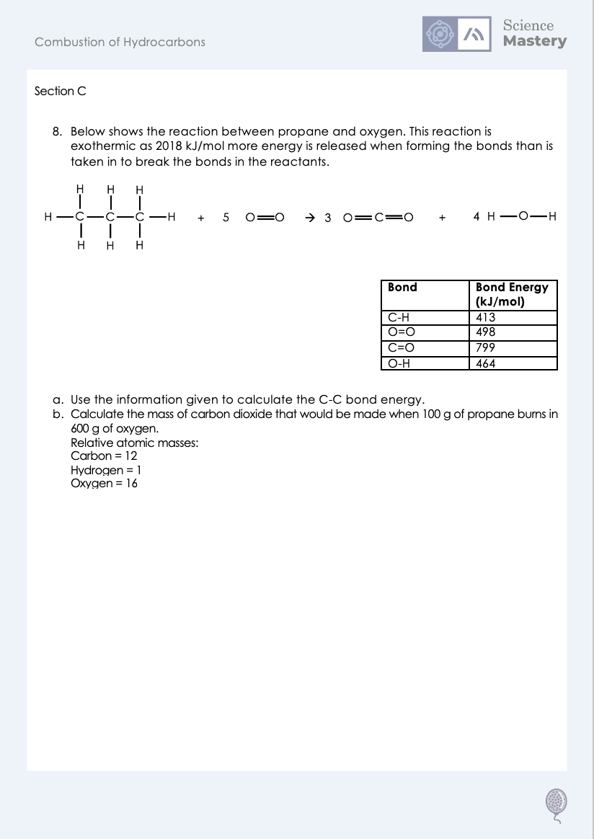
Worksheet

Slide 21
Answers
1. B - A molecule that contains carbon and hydrogen atoms only
2. C₃H₈
3. B - Oxygen
4. Alkane + oxygen → carbon dioxide + water
5. A good supply of oxygen/air

Slide 22
Answers
6a. CH₄ + 2 O₂ → CO₂ + 2 H₂O
6b. It produces carbon monoxide, which is poisonous/toxic/stops oxygen binding to haemoglobin in blood.
6c.
6d. It is exothermic, so the reactants have more energy than the products.
Energy
Reactants
Products
Progress of reaction

Slide 23
Answers
7a. Octane + oxygen → carbon dioxide + water
7b. Sulfur impurities react with oxygen to form sulfur dioxide, which leads to acid rain.
7c. Carbon dioxide, as it is contributing to global warming.
7d. 14.83%
7e. Water (vapour)/steam

Slide 24
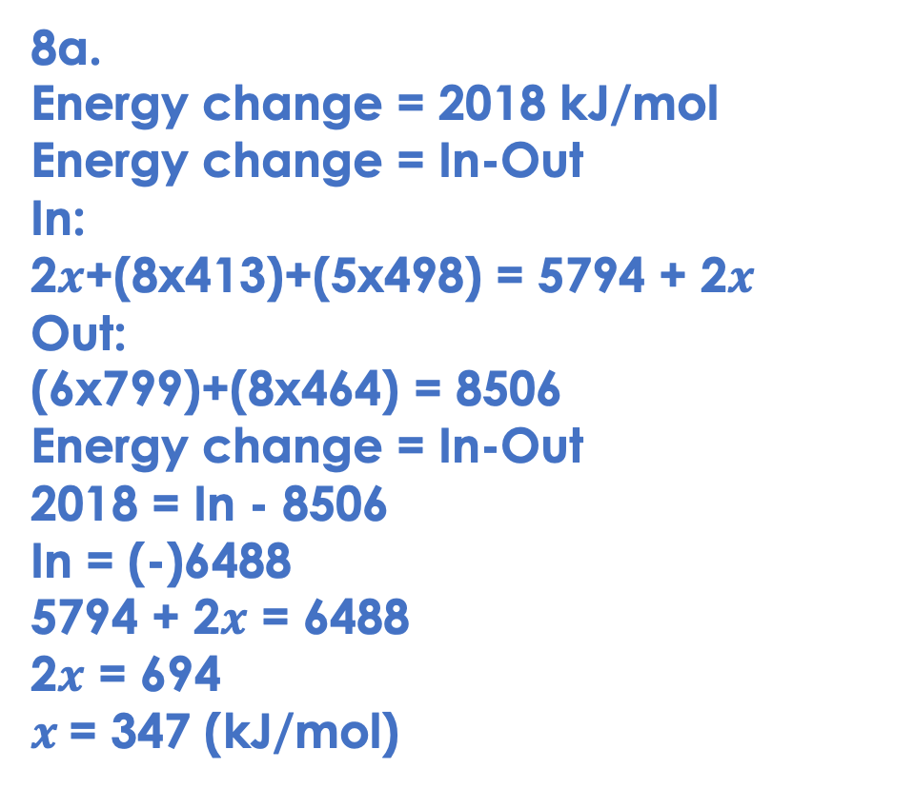
Answers
8a.
Energy change = 2018 kJ/mol
Energy change = In-Out
In:
2$x$+(8x413)+(5x498) = 5794 + 2$x$
Out:
(6x799)+(8x464) = 8506
Energy change = In-Out
2018 = In - 8506
In = (-)6488
5794 + 2$x$ = 6488
2$x$ = 694
$x$= 347 (kJ/mol)

Slide 25
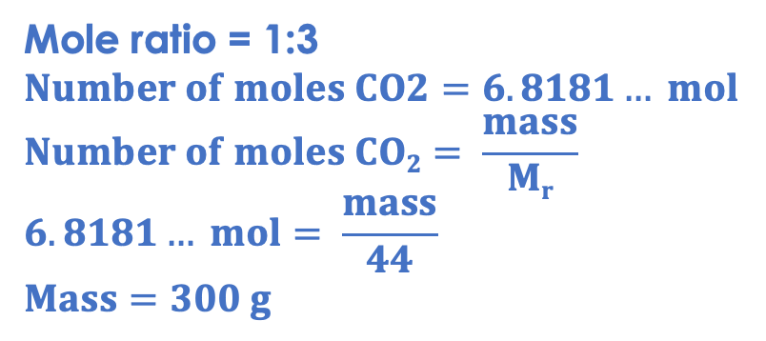
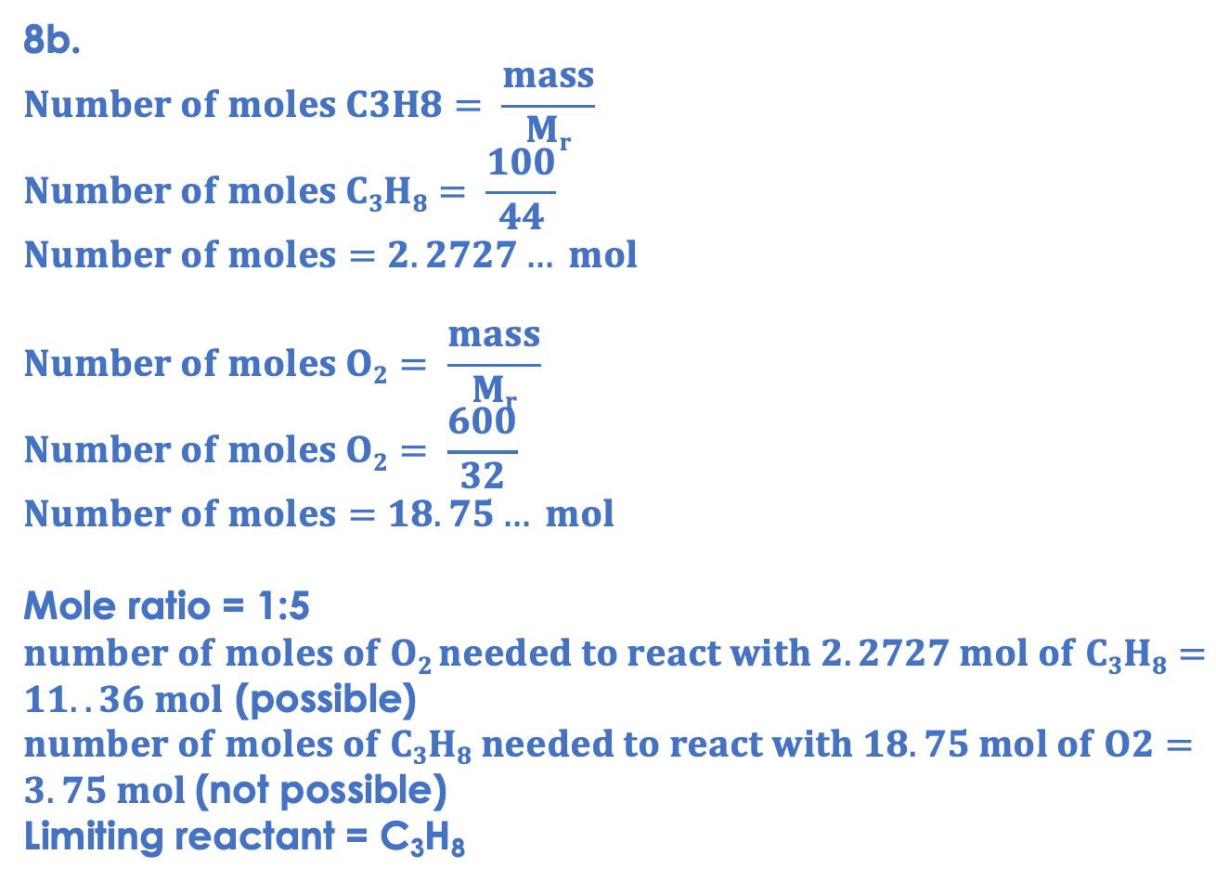
Answers
8b.
$$Number of moles C3H8= \frac{mass}{Mr}$$
$$Number of moles C3H8= \frac{100}{44}$$
$$Number of moles=2.2727… mol$$
$$Number of moles O2= \frac{mass}{Mr}$$
$$Number of moles O2= \frac{600}{32}$$
$$Number of moles=18.75… mol$$
Mole ratio = 1:5
$number of moles of O2 needed to react with 2.2727 mol of C3H8=11..36 mol$ (possible)
$number of moles of C3H8 needed to react with 18.75 mol of O2=3.75 mol$(not possible)
Limiting reactant = C₃H₈
Mole ratio = 1:3
$$Number of moles CO2=6.8181… mol$$
$$Number of moles CO2= \frac{mass}{Mr}$$
$$6.8181… mol= \frac{mass}{44}$$
$$Mass=300 g$$

Slide 26
Answer the questions below.
Which is the correct general equation for the combustion of alkanes?
A. Alkane + water → oxygen + carbon dioxide
B. Alkane + oxygen → water + carbon dioxide
C. Alkane + air → water + carbon dioxide
✓
Which is an advantage of burning hydrocarbons?
A. It releases lots of energy
B. It releases carbon dioxide
C. It releases water
✓
When does incomplete combustion take place?
A. If there is not enough oxygen
B. If there is not enough alkane
C. If there is not the same amount of alkane and oxygen
✓
Notes:
Q1. Answer: B
If students answer A, they have confused reactants and products. If students answer C, they have the misconception that a substance reacts with air when it burns. To fix it, review what happens in a combustion reaction and review the general equation for combustion of alkanes.
Q2. Answer: A
If students answer B, they are not clear on why carbon dioxide production is a disadvantage. If students answer C, they have the misconception that we burn hydrocarbons to get water, rather than to release energy, which is a surprisingly common misconception based on the word equation. To fix it, review the advantages and disadvantages of burning hydrocarbons.
Q3. Answer: A
If students answer B, they have not recognised the correct limiting reactant. If students answer C, they have assumed that there need to be equal amounts for the reaction to fully take place. To fix it, it can be useful to show students with a quantitative example with oxygen as the limiting reactant.

Slide 27
Lesson C5.1.4
What was good about this lesson? | What can we do to improve this lesson?
Send us your feedback by clicking this link
or by emailing sciencemastery@arkonline.org
Thank you!

